Slide 1
Michal Kaplan, Czech Ministry of Foreign Affairs Late Night Diplomacy, Prague, 16 May 2022
Czech Presidency
in insecure Europe

Slide 2
What are we going to talk about?
CZ Presidency Framework and Documents
EU foreign policy and external relations
Role of the Czech MFA after the Lisbon Treaty
Role of embassies abroad
Topics relevant for the CZ PRES (external relations)
Events during CZ Presidency
Impact of the Russian war in Ukraine

Slide 3
CZ Presidency Framework and Documents
EU Global Strategy (2016)
Strategic Agenda (2019-2024)
Trio FR+CZ+SE Programme (December 2021)
Progress of French Presidency
Commission Work Programme
European Council Counclusions
Current developments (war in Ukraine)
Czech Presidency Programme (mid-June 2022)
Calendar of Council meetings and Working Parties

Slide 4
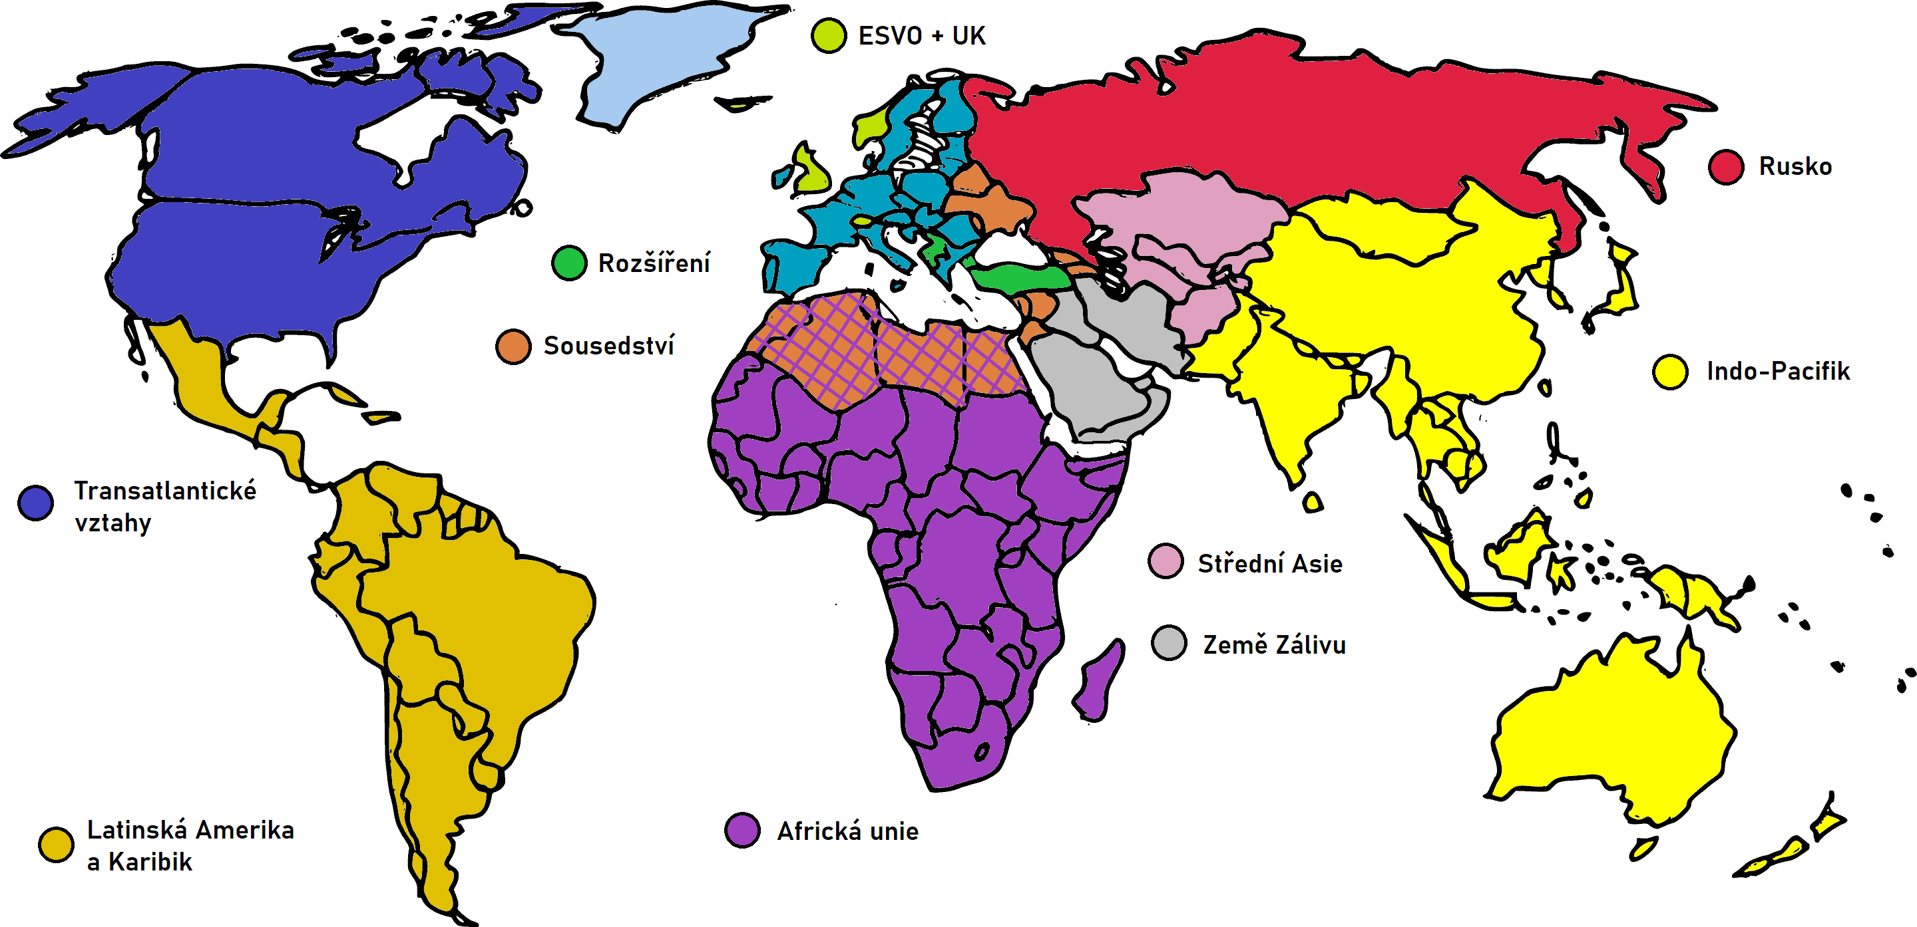

Slide 5
Role of the Czech MFA after the Lisbon Treaty
Different from the first Presidency in 2009.
New role of the High Representative
New role of the European External Action Service (EEAS).
Presidency does not chair FAC or European Council.
Local presidency only in few countries.

Slide 6
Embassies’ role during the CZ Presidency
PR-EU
Brussels
Local RES
Teheran, Doha
Embassies
in EU member states (EU27)
Missions
to NATO, UN, OECD, OSCE
Other
Embassies and consulates in third countries

Slide 7
Topics in international relations
Horizontal
Strong Europe
Resilient Europe
Geografical
Eastern Europe
Western Balkans
Indo-Pacifik and the Sahel
United and effective CFSP
Transatlantic relations
External aspects of terrorism
Sustainable Europe
Geopolitics of emerging technologies
Strategic communication
Green diplomacy
Human rights
Development cooperation
Ukraine
Stabilisation of the region
Indo-Pacifik
External dimension of energy
External dimension of migration
Eastern neighbourhood
Russia
Support of the accession process
Dialogue btw Serbia-Kosovo, B-H situation
Sahel
Strengthening CSDP

Slide 8
CZ Presidency events at the MFA
41 official events in the Czech Republic and 4 abroad
informal Foreign Affairs Council – Gymnich
Forum on European Ukraine
High Level Forum on Indo-Pacific
informal COREPER trips + COPS trip
PRESS trip for journalists to Czechia
Possible summit(s) with third countries (tbc)

Slide 9
Impact of the Russian war in Ukraine
Support to Ukraine
Future of Eastern Partnership
Relations with Russia
Enlargement policy (Balkans)
Transatlantic relations
Defense (EU-NATO)
Hybrid threats (cyber security)
Strategic communication
Multilateralism (UN)
Democracy and human rights
Relations with third countries
Energy security
Migration and refugees
Humanitarian aid

Slide 10
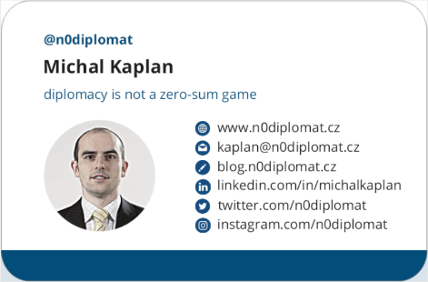
Questions?

